Slide 1

OPERATING SYSTEMS
Introduction, Computer System Organization
Suresh Jamadagni
Department of Computer Science

Slide 2

OPERATING SYSTEMS
Slides Credits for all the PPTs of this course
The slides/diagrams in this course are an adaptation, combination, and enhancement of material from the following resources and persons:
Slides of Operating System Concepts, Abraham Silberschatz, Peter Baer Galvin, Greg Gagne - 9th edition 2013 and some slides from 10th edition 2018
Some conceptual text and diagram from Operating Systems - Internals and Design Principles, William Stallings, 9th edition 2018
Some presentation transcripts from A. Frank – P. Weisberg
Some conceptual text from Operating Systems: Three Easy Pieces, Remzi Arpaci-Dusseau, Andrea Arpaci Dusseau

Slide 3
OPERATING SYSTEMS
Introduction, Computer System Organization
Suresh Jamadagni
Department of Computer Science
Notes:
I am going to introduce Operating System, what they are, what they do and why it’s important.
OS runs on computers, mobiles, gadget and many other devices.
Thorough OS knowledge is required to work on System Software including Compilers and Device Drivers.
Real Time OS is used in embedded systems, TVs, Car/Game Consoles.
Multiple Operating Systems: UNIX, Linux, Windows, Mac OS, Android, Solaris, HP-UX, IBM AIX, BSD

Slide 4
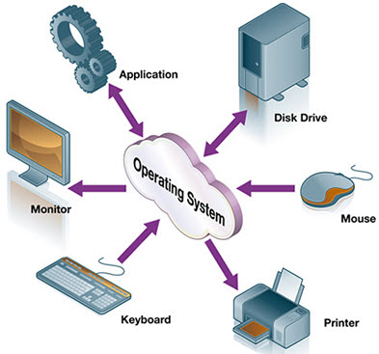
OPERATING SYSTEMS
Need for Operating System
If OS is not developed then how will the application developers access the hardware?

Slide 5
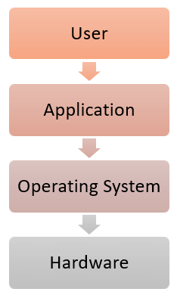
OPERATING SYSTEMS
General Definition
An Operating System is a program(system software) that acts as an intermediary between a user of a computer and the computer hardware
It provides a user-friendly environment in which a user may easily develop and execute programs. Otherwise, hardware knowledge would be mandatory for computer programming.

Slide 6
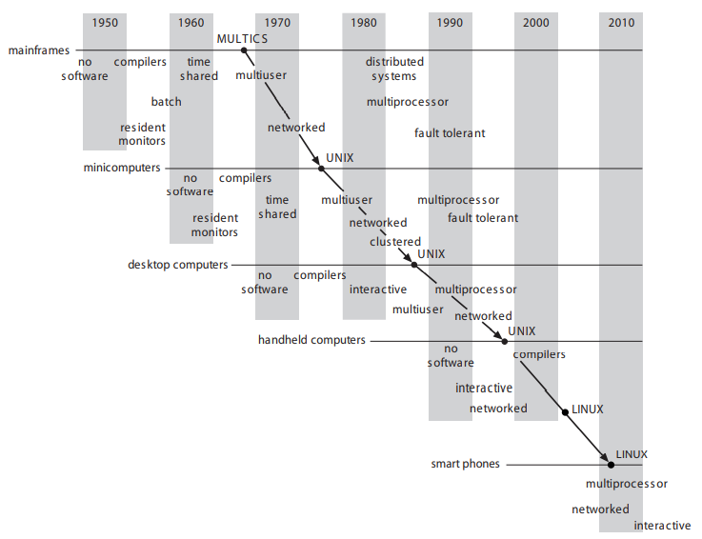
OPERATING SYSTEMS
Genesis

Slide 7
OPERATING SYSTEMS
Operating System Goals
Execute user programs and make solving user problems easier
Make the computer system convenient to use
Use the computer hardware in an efficient manner
Manage resources such as
• Memory
• Processor(s)
• I/O Devices
Notes:
OS manages hardware, allocates resources, controls program execution and provides user program environment

Slide 8
OPERATING SYSTEMS
Why Study Operating Systems?
Only a small percentage of computer practitioners will be involved in the creation or modification of an operating system.
However almost all code runs on top of an operating system, and thus knowledge of how operating systems work is crucial to proper, efficient, effective, and secure programming.
Understanding the fundamentals of operating systems
Notes:
OS manages hardware, allocates resources, controls program execution and provides user program environment

Slide 9
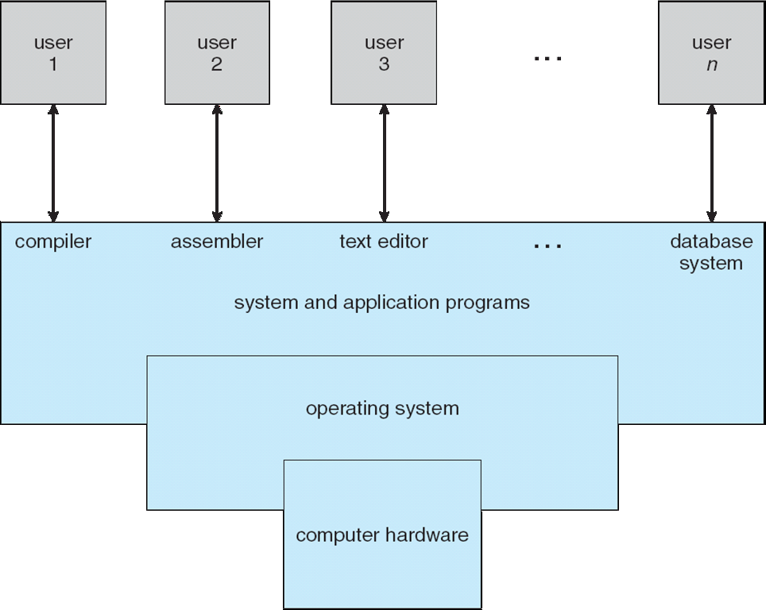
OPERATING SYSTEMS
Four Components of a Computer System (Abstract view)
© copyright Silberschatz, Galvin and Gagne, 2013

Slide 10
OPERATING SYSTEMS
Computer System Structure
Hardware – provides basic computing resources
CPU, memory, I/O devices
Operating system
Controls and coordinates use of hardware among various applications and users
Application programs – define the ways in which the system resources are used to solve the computing problems of the users
Word processors, web browsers, database systems, video games
Users
People, machines, other computers
Notes:
Computer system can be divided into four components: Hardware, OS, Application Programs and Users

Slide 11
OPERATING SYSTEMS
What Operating Systems Do
Depends on the point of view: User View, System View
Users want convenience, ease of use and good performance
Don’t care about resource utilization
But shared computer such as mainframe or minicomputer must keep all users happy.
Maximize resource utilization.
Available CPU time, memory, and I/O are used efficiently and that no individual user takes more than her fair share
Notes:
Three conceptual pieces that are fundamental to operating systems: Virtualization (CPU scheduling, Process management, Memory management – Paging & Segmentation), Concurrency (like Threads, locks, condition variables & Semaphores), and Persistence (I/O devices, file systems, storage, data integrity/protection, Distributed Systems, NFS).

Slide 12
OPERATING SYSTEMS
What Operating Systems Do? a)User View
Users of dedicated systems such as workstations have dedicated resources but frequently use shared resources from servers.
resources like file, compute, and print servers are shared.
operating system is designed to compromise between individual usability and resource utilization
Handheld computers are resource poor, optimized for usability and battery life.
Some computers have little or no user interface, such as embedded computers in devices and automobiles
Notes:
Three conceptual pieces that are fundamental to operating systems: Virtualization (CPU scheduling, Process management, Memory management – Paging & Segmentation), Concurrency (like Threads, locks, condition variables & Semaphores), and Persistence (I/O devices, file systems, storage, data integrity/protection, Distributed Systems, NFS).

Slide 13
OPERATING SYSTEMS
b)System View
OS is a resource allocator
Manages all resources
Decides between conflicting requests for efficient and fair resource use
OS is a control program
Controls execution of programs to prevent errors and improper use of the computer
Notes:
At Computer Startup, bootstrap program (or loader) is loaded at power-up or reboot
Typically stored in ROM or EPROM, generally known as firmware
Initializes all aspects of system
Loads operating system kernel and starts execution

Slide 14
OPERATING SYSTEMS
Defining Operating System
The OS has many roles and functions
The fundamental goal of computer systems is to execute user programs and to make solving user problems easier.
The common functions of controlling and allocating resources are then brought together into one piece of software: the operating system
“The one program running at all times on the computer” is the kernel.
Everything else is either
a system program (ships with the operating system) , or
an application program.
Notes:
At Computer Startup, bootstrap program (or loader) is loaded at power-up or reboot
Typically stored in ROM or EPROM, generally known as firmware
Initializes all aspects of system
Loads operating system kernel and starts execution

Slide 15
OPERATING SYSTEMS
Computer System Organization
Computer-system consists of,
One or more CPUs, device controllers connect through common bus providing access to shared memory
The CPU and the device controllers can execute concurrently, competing for memory cycles.
memory controller is provided to synchronize access to the memory.
© copyright Silberschatz, Galvin and Gagne, 2013

Slide 16
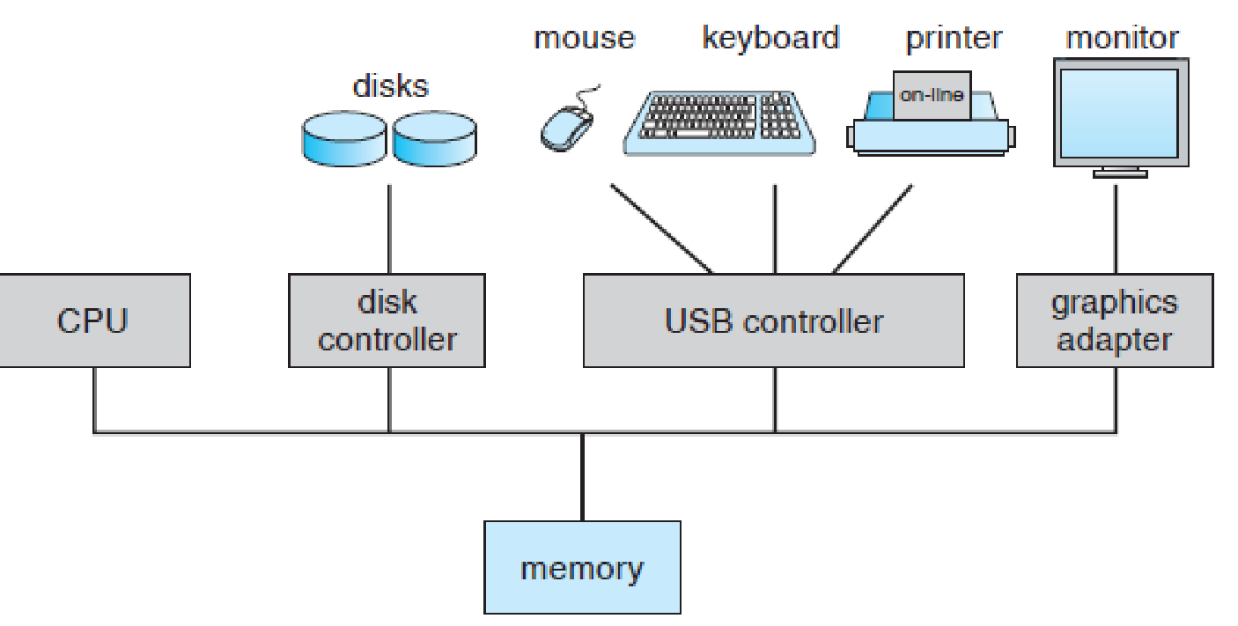
OPERATING SYSTEMS
Computer System Organization
A modern computer system
© copyright Silberschatz, Galvin and Gagne, 2013

Slide 17
OPERATING SYSTEMS
Computer System Operation
I/O devices and the CPU can execute concurrently.
Each device controller is in charge of a particular device type.
Each device controller has a local buffer.
Each device controller has registers for action (like “read character from keyboard”) to take.
CPU moves data from/to main memory to/from local buffers.
I/O is from the device to local buffer of controller.
Device controller informs CPU that it has finished its operation by causing an interrupt.

Slide 18
OPERATING SYSTEMS
Computer System Organization
When the system is booted, the first program that starts running is a Boostrap.
It is stored in Read Only Memory (ROM) or Electrically Erasable Programmable Read Only Memory (EEPROM).
Bootstrap is known by the general term firmware, within the computer hardware.
It initializes all aspects of the system, from CPU registers to device controllers to memory contents.
The bootstrap program must know how to load the operating system and how to start executing that system.
The bootstrap program must locate and load into memory the operating system kernel.
The first program that is created is init, after the OS is booted. It waits for the occurrence of event.
© copyright Silberschatz, Galvin and Gagne, 2013

Slide 19
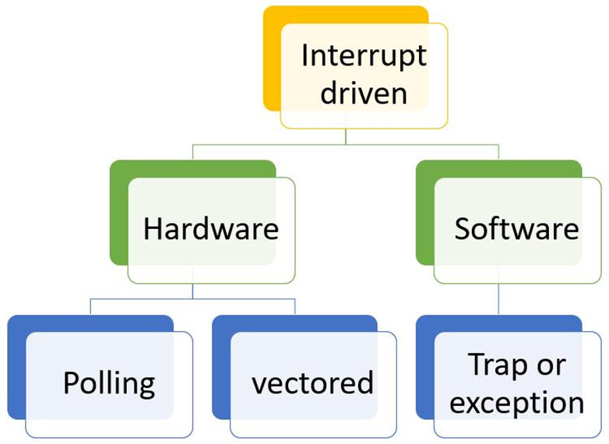
OPERATING SYSTEMS
Common Functions of Interrupts
An operating system is interrupt driven
Interrupt transfers control to the interrupt service routine generally, through the interrupt vector, which contains the addresses of all the service routines
Interrupt architecture must save the address of the interrupted instruction
A trap or exception is a software-generated interrupt caused either by an error or a user request
Notes:
Interrupt: Interrupt is a hardware mechanism in which, the device notices the CPU that it requires its attention. Interrupt can take place at any time. So when CPU gets an interrupt signal through the indication interrupt-request line, CPU stops the current process and respond to the interrupt by passing the control to interrupt handler which services device.
Polling: In polling is not a hardware mechanism, its a protocol in which CPU steadily checks whether the device needs attention. Wherever device tells process unit that it desires hardware processing, in polling process unit keeps asking the I/O device whether or not it desires CPU processing. The CPU ceaselessly check every and each device hooked up thereto for sleuthing whether or not any device desires hardware attention. Each device features a command-ready bit that indicates the standing of that device, i.e., whether or not it’s some command to be dead by hardware or not. If command bit is ready one, then it’s some command to be dead else if the bit is zero, then it’s no commands.
Polled interrupt is an inefficient method of data transfer, spending much time checking the ready condition of a computer's devices. An alternative that is more efficient is a vectored interrupt, which can send a signal that includes the identity of the device.
The main difference between interrupt and polling is that, in the case of an interrupt, the system informs the CPU that it needs attention, while talking about polling, the CPU constantly inspects the status of the system to find whether it needs attention.

Slide 20
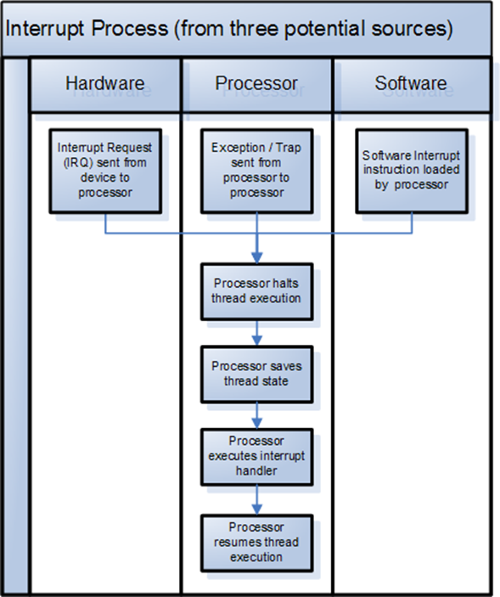
OPERATING SYSTEMS
Interrupt Handling
The operating system saves the state of the CPU by storing registers and the program counter
Determines which type of interrupt has occurred:
polling
vectored interrupt system
Separate segments of code determine what action should be taken for each type of interrupt
Notes:
In a computer, a polled interrupt is a specific type of I/O interrupt that notifies the part of the computer containing the I/O interface that a device is ready to be read or otherwise handled but does not indicate which device. The interrupt controller must poll (send a signal out to) each device to determine which one made the request. Polled interrupt is an inefficient method of data transfer, spending much time checking the ready condition of a computer's devices.
The alternative to a polled interrupt is a vectored interrupt , an interrupt signal that includes the identity of the device sending the interrupt signal.

Slide 21
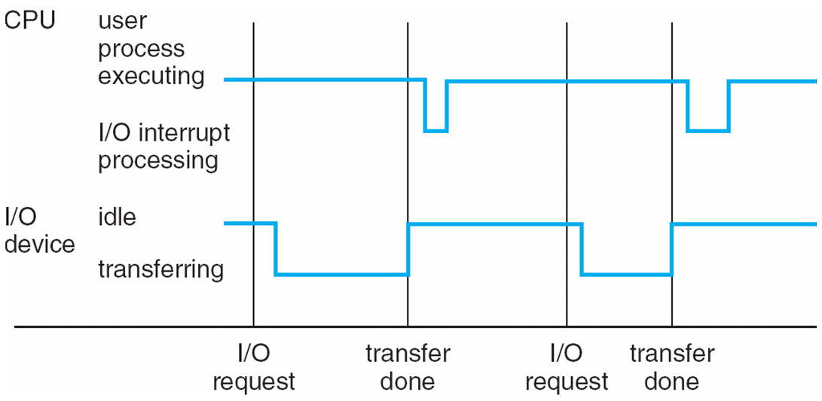
OPERATING SYSTEMS
Interrupt Timeline for a single process doing output
Interrupt processing times vary..
..and so do I/O transfer times

Slide 22
OPERATING SYSTEMS
Storage Structure
Main memory – only large storage media that the CPU can access directly (Random access memory and typically volatile)
Implemented with semiconductor technology called DRAM
Computers use other forms of memory like ROM, EEPROM
Smart phones have EEPROM to store factory installed programs.

Slide 23
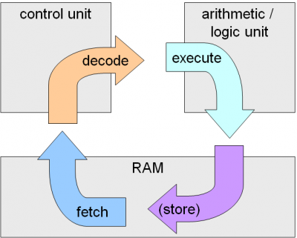
OPERATING SYSTEMS
Program Execution Model
Typical instruction execution
1)Fetch
2)Decode
3)Execute
4)Writeback
The processor fetches instructions from memory, decodes and executes them.
The Fetch, Decode and Execute cycles are repeated until the program terminates.
This is called the Von Neumann model of computing.
Image source :https://computersciencewiki.org/index.php/The_machine_instruction_cycle

Slide 24
OPERATING SYSTEMS
Storage Structure
Secondary storage – extension of main memory that provides large nonvolatile storage capacity
Hard disks – rigid metal or glass platters covered with magnetic recording material
Disk surface is logically divided into tracks, which are subdivided into sectors
The disk controller determines the logical interaction between the device and the computer
Solid-state disks – faster than hard disks, nonvolatile
Various technologies and becoming more popular
Flash memory used in camera’s PDA’s
Notes:
A solid-state drive (SSD) is a solid-state storage device that uses integrated circuit assemblies to store data persistently, typically using flash memory, and functions as secondary storage in the hierarchy of computer storage. It is also sometimes called a semiconductor storage device, a solid-state device, or a solid-state disk,even though SSDs lack the physical spinning disks and movable read-write heads used in hard disk drives (HDDs) and floppy disks. SSD also has rich internal parallelism for data processing.

Slide 25
OPERATING SYSTEMS
Storage Hierarchy
Storage systems organized in hierarchy
Speed
Cost
Volatility
Caching – copying information into faster storage system; main memory can be viewed as a cache for secondary storage

Slide 26
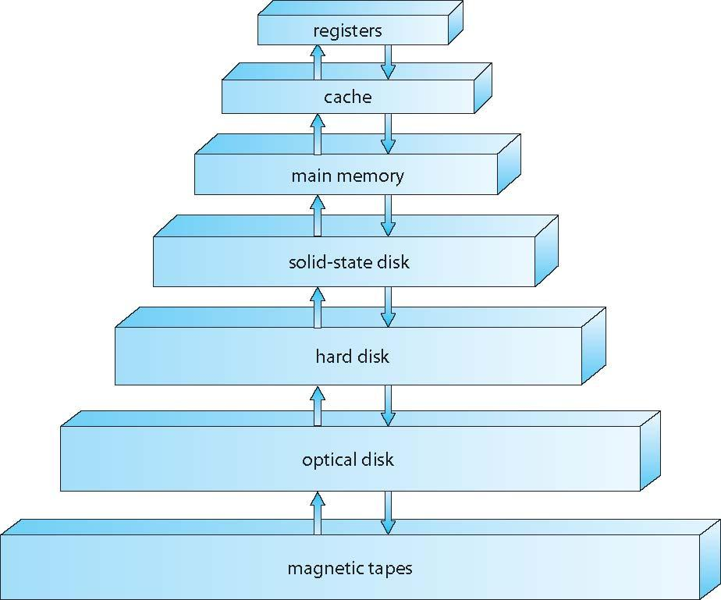
OPERATING SYSTEMS
Storage-Device Hierarchy

Slide 27
OPERATING SYSTEMS
Caching
Important principle, performed at many levels in a computer (in hardware, operating system, software)
Information in use copied from slower to faster storage temporarily
Faster storage (cache) checked first to determine if information is there
If it is, information used directly from the cache (fast)
If not, data copied to cache and used there
Cache smaller than storage being cached
Cache management important design problem
Cache size and replacement policy

Slide 28
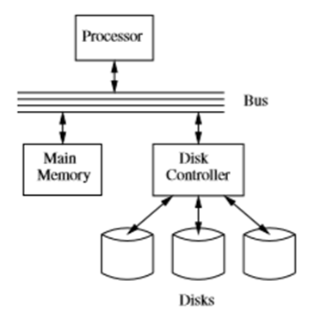
OPERATING SYSTEMS
I/O Structure
Storage is a type of I/O device
A large portion of operating-system code is dedicated to managing I/O
As reliability and performance of a system is the main concern.
General-purpose computer system consists of CPUs and multiple device controllers that are connected through a common bus.
Each device controller is in charge of a specific type of device.
Device Driver for each device controller to manage I/O
Provides uniform interface between controller and kernel
Small Computer-Systems Interface (SCSI)controller enables to connect more devices.

Slide 29
OPERATING SYSTEMS
I/O Structure
A device controller maintains some local buffer storage and a set of special-purpose registers.
The device controller is responsible for moving the data between the peripheral devices.

Slide 30
OPERATING SYSTEMS
I/O Structure
After I/O starts, control returns to user program only upon I/O completion
Wait instruction idles the CPU until the next interrupt
Wait loop (contention for memory access)
At most one I/O request is outstanding at a time, no simultaneous I/O processing
After I/O starts, control returns to user program without waiting for I/O completion
System call – request to the OS to allow user to wait for I/O completion
Device-status table contains entry for each I/O device indicating its type, address, and state
OS indexes into I/O device table to determine device status and to modify table entry to include interrupt.

Slide 31
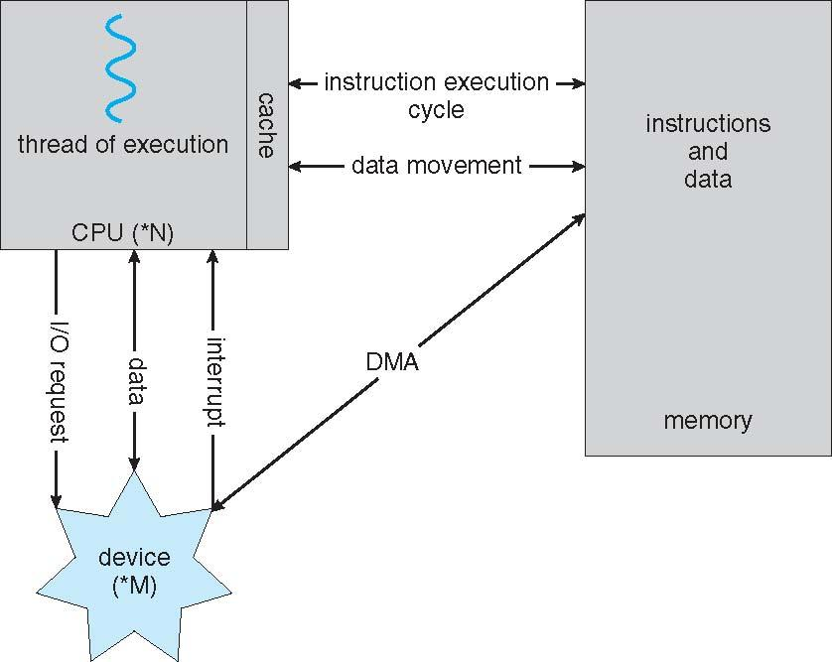
OPERATING SYSTEMS
Direct Memory Access Structure
Used for high-speed I/O devices able to transmit information at close to memory speeds.
Device controller transfers blocks of data from buffer storage directly to main memory without CPU intervention.
Only one interrupt is generated per block, rather than the one interrupt per byte.

Slide 32
THANK YOU
Suresh Jamadagni
Department of Computer Science Engineering
sureshjamadagni@pes.edu

